Slide 1

Music management web app Presentation
Neel Dudhia

Slide 2
Introduction

Slide 3
Technologies
Back end:
JAVA
Spring
Front End:
HTML
CSS
JavaScript
Database:
MySQL server
Testing:
JUnit
Mockito
Selenium
Build tool:
Maven
Version Control:
Git
Scrum Board:
Jira
Statistical Analysis:
SonarQube
Notes:
The back end was developed in JAVA using the spring boot framework. Spring is an inversion of control container which essentially handles the core functionalities and allows spring to take control of creating instances of classes or beans. The back end used spring boot. The front end and back end connection was managed by Spring web and the the Datatbase and back end was managed by spring data. There were 3 main classes used , the domain class which was annotated by the @Entity component, the controller which was annotated by the @RestController anotation ( allowing us to return data in JSON format) , and the service class annotated by the @Service component. The controller allowed us to make API requests to the database. The 5 types of request were get, post, put, and delete.
For the front end we learned to design the web page in html making use of the bootstrap to make the page more responsive and user friendly. This was connected to a js file which would make axios api requests to the back end which connected the logic and presentation layers I was talking about before.
In testing we used x, y, z and the project was complied on the main branch using maven.
I was also able to further develop my Git and Jira skills .

Slide 4
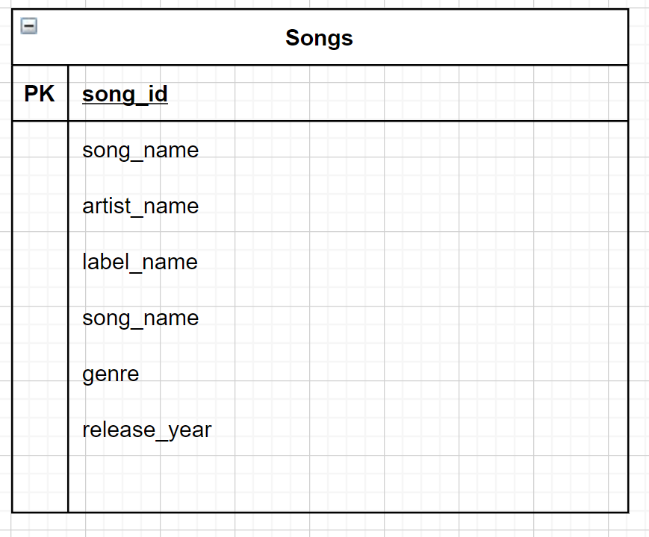
ERD DIAGRAM

Slide 5
Risk Assessment
Description | Evaluation | Likelihood | Responsibility | Impact Level | Response | Control Measures
1.Software issues | Issues with software being temperamental can cause a bottleneck in the development cycle | Medium | Developer | Medium | Ensure that all software is up to date. | Restarting computer Maven -> Update project
2. Security | Possibility of viruses when downloading different software from internet | Low | Developer | High | Be careful when downloading things from internet. Read through description and check URL to ensure it is the right download | Use VPN to protect personal data Anit-Virus Software
3. Human error | Errors occurring to tiredness or silly mistakes. Can lead to loss of code | Low | Developer | High | Take regular breaks and carefully check over code before submitting | Request at least one code review before merging branches
4.Scope of work | Poorly specifying and scope creep can lead to a failure of meeting time constraints + not satisfying MYP | Medium | Project Mangers | Medium | Replan the scope at each iteration. Create effective sprints with effective user stories and acceptance criteria | AGILE principles

Slide 6
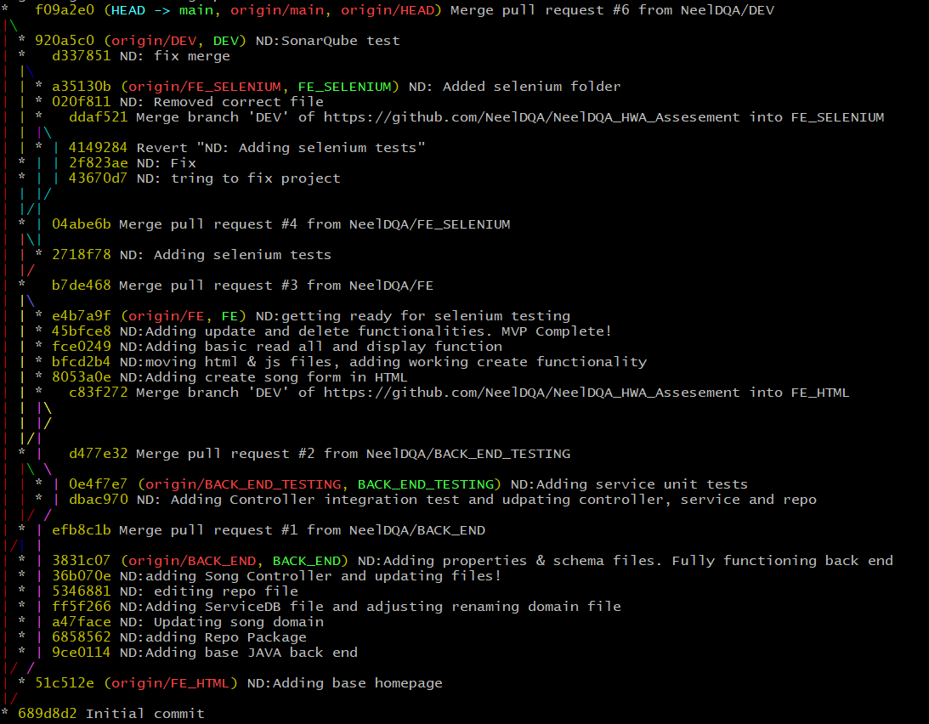
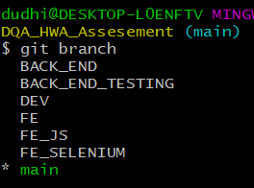
Version Control

Slide 7
JIRA

Slide 8
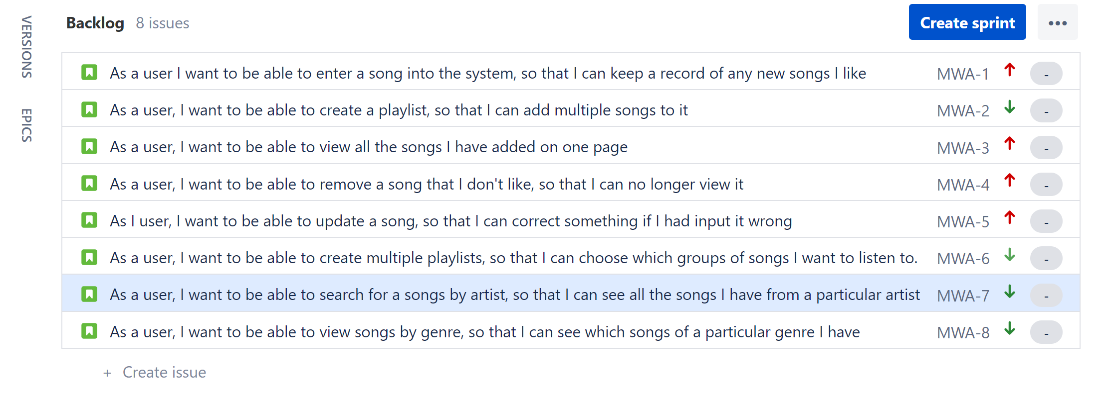
Initial Backlog

Slide 9
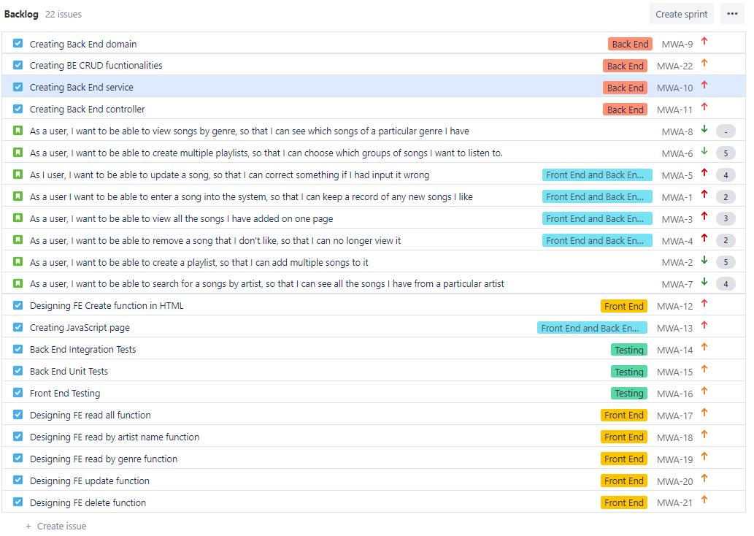
Final Backlog

Slide 10
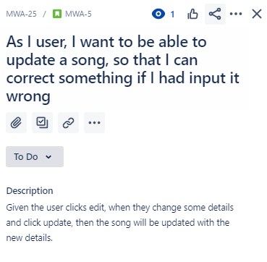
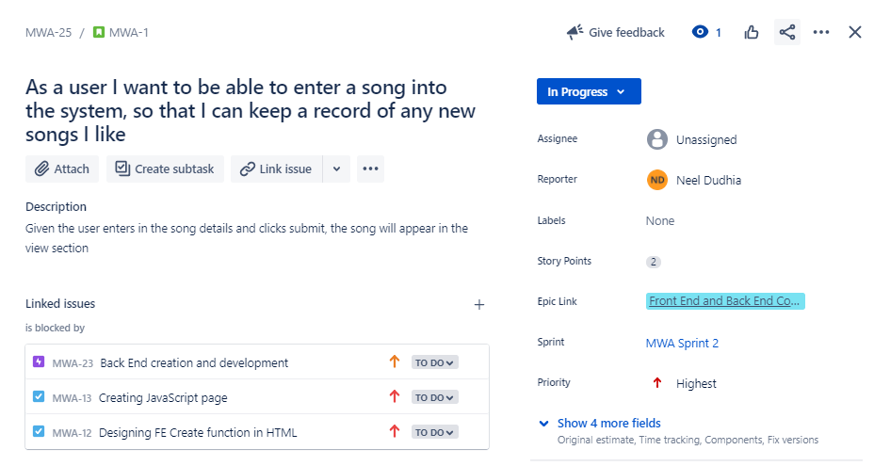
Acceptance Criteria & Linked Issues

Slide 11
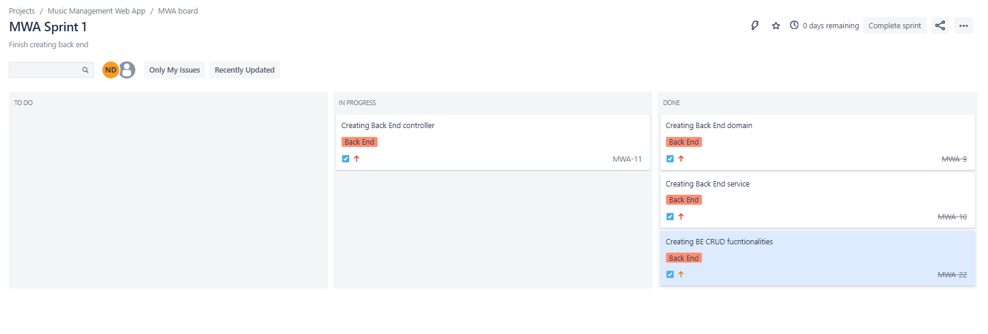
Sprint 1

Slide 12
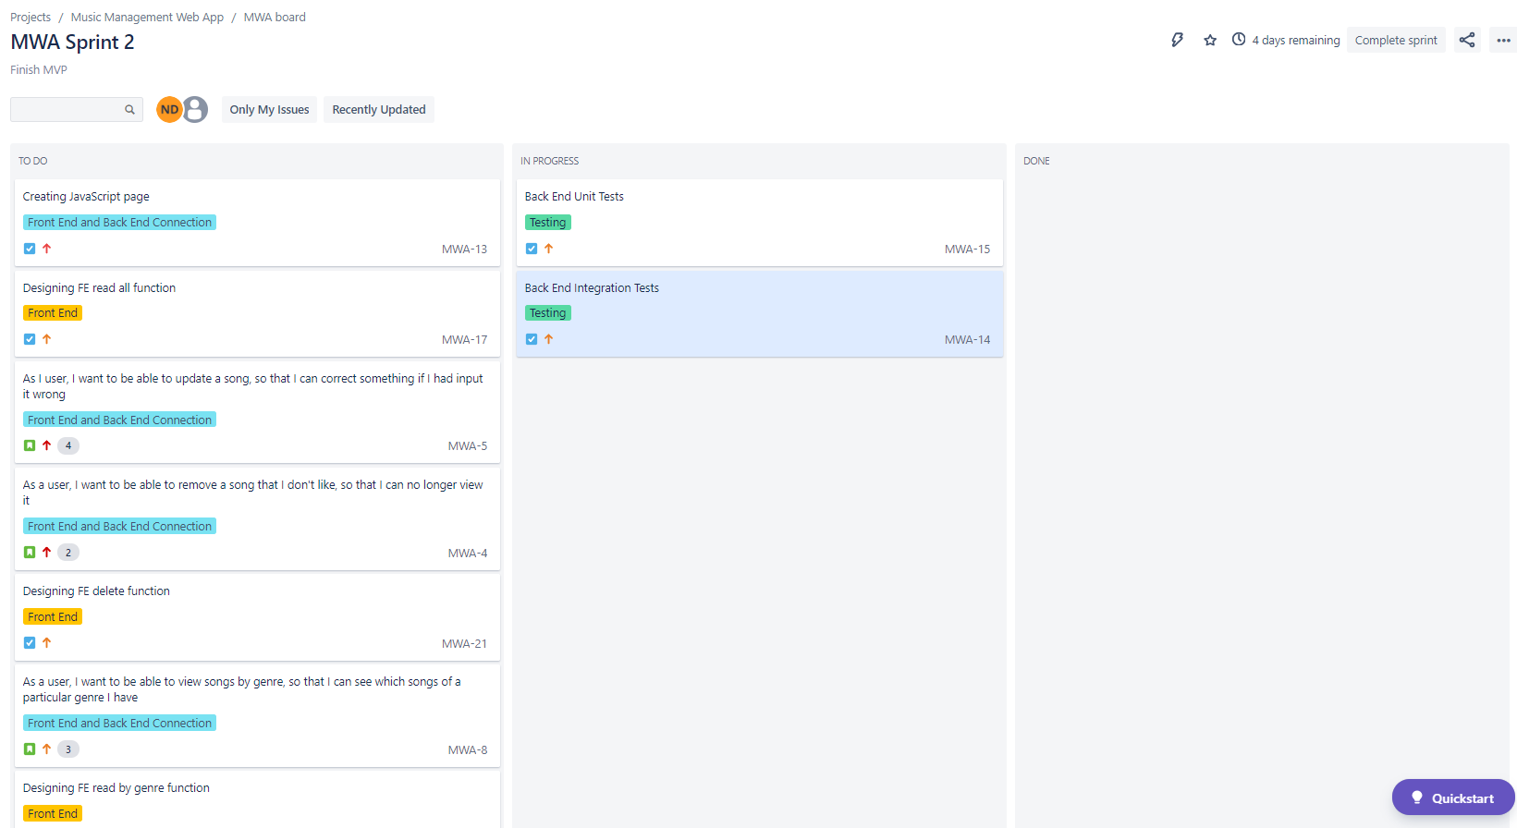
Sprint 2 – DAY 1

Slide 13
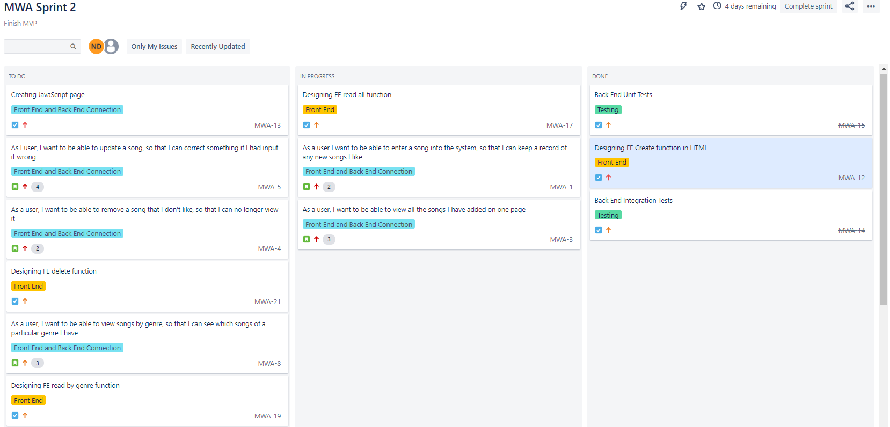
Sprint 2 – Day 2

Slide 14
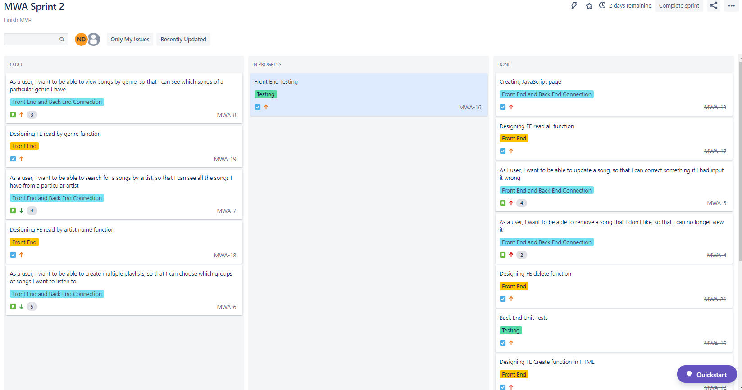
Sprint 2 – Day 4

Slide 15
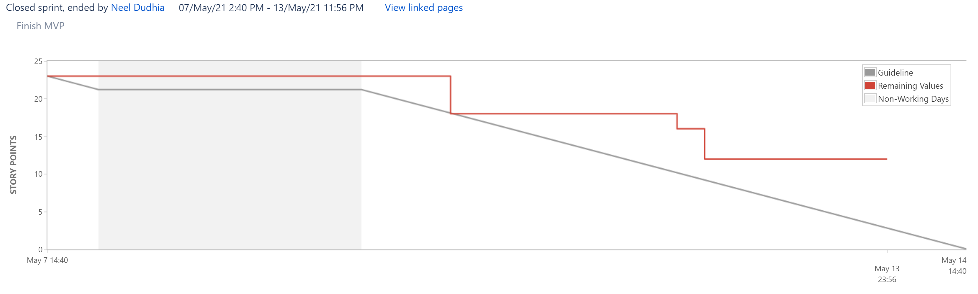
Burndown Chart

Slide 16
Testing

Slide 17
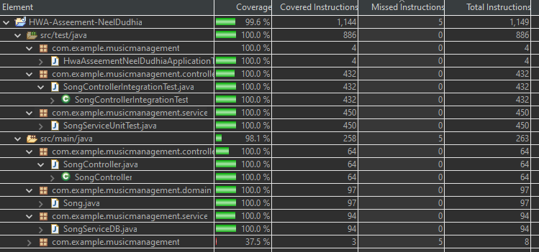
Coverage

Slide 18
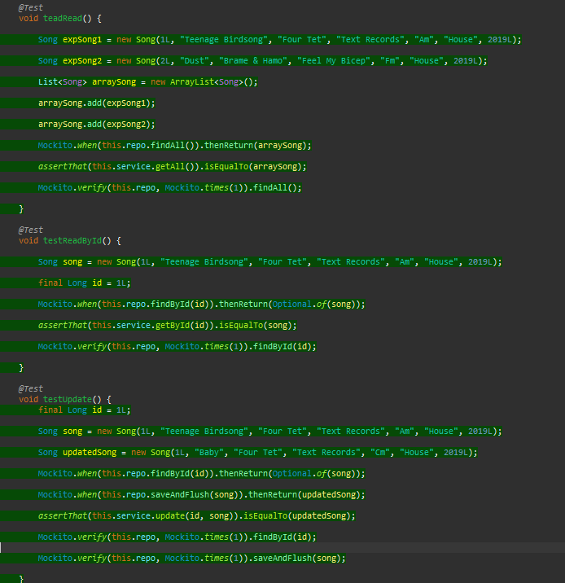
Unit Testing

Slide 19
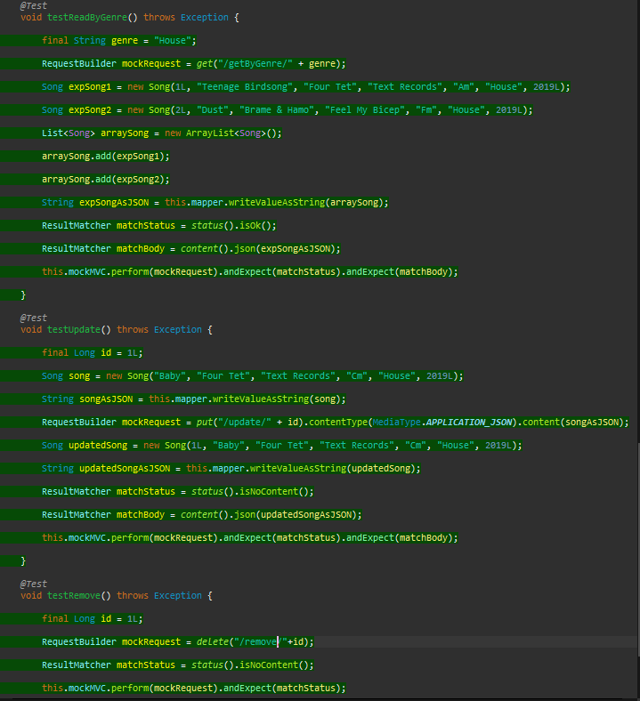
Integration Testing

Slide 20
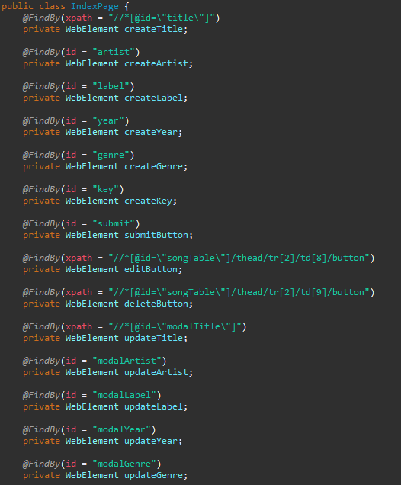
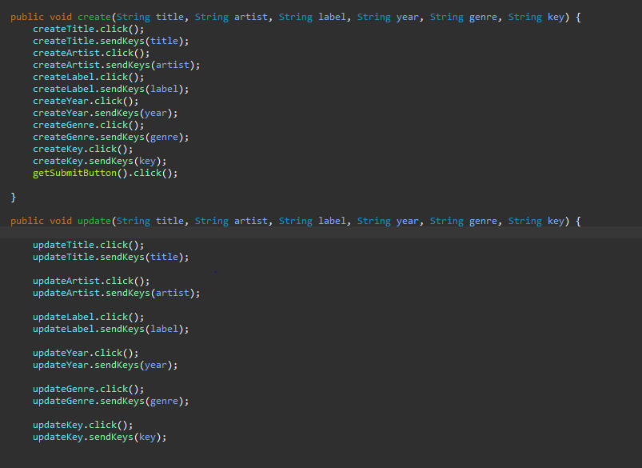
Selenium Page

Slide 21
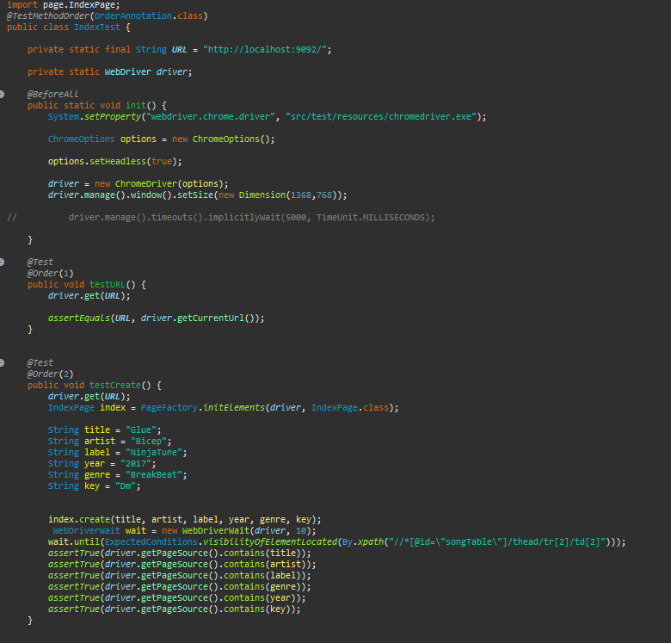
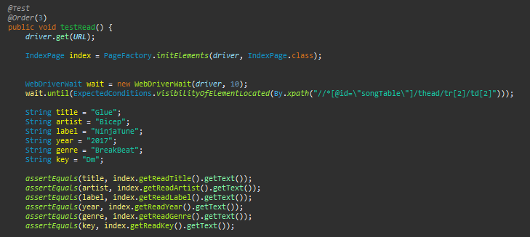
Selenium Test

Slide 22
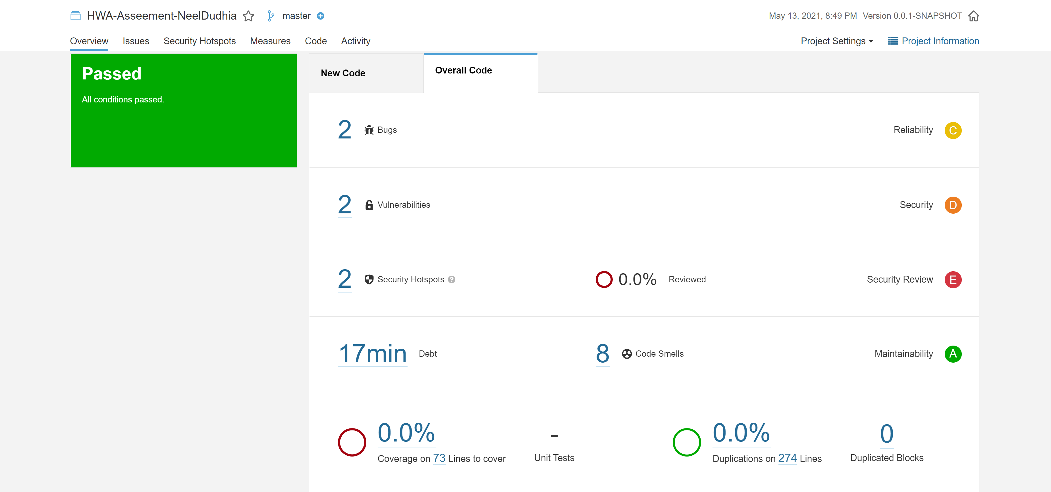
SonarQube

Slide 23
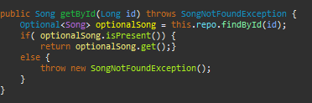
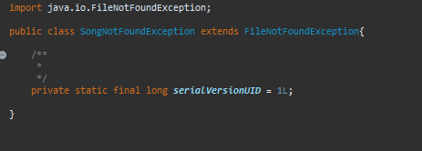
Bugs
Notes:
First I tackled the bugs . The bugs stated to call
Adding optionals is present and surrounding with throws exception. I then created a dedicated expception called song not found exception which extended file not found exception. It then asked me to review some code regarding cross origin implemented due to CORS policy error on the front end. I reviewed the code and decided nothing was to be done .

Slide 24
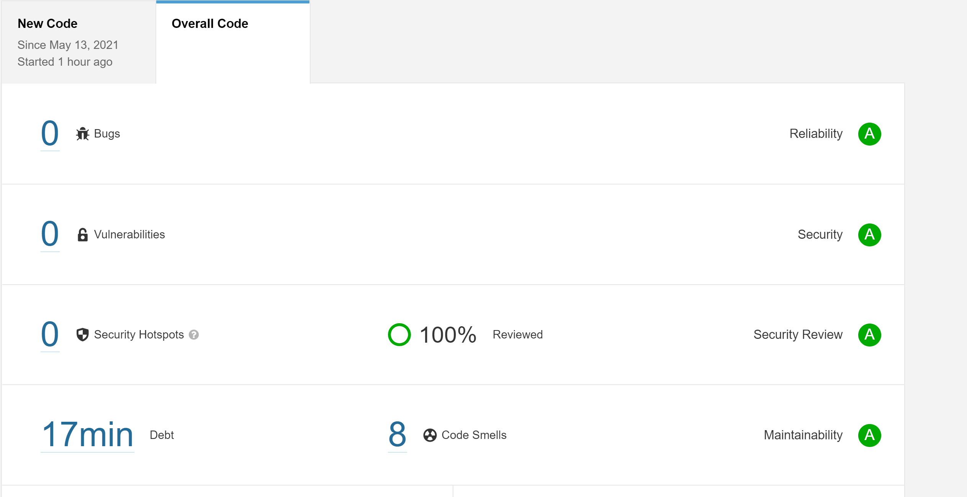

Slide 25
Demonstration

Slide 26
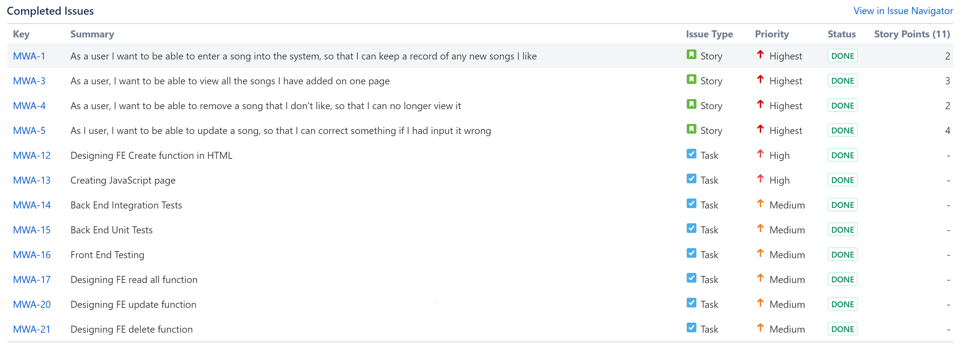
Sprint Review

Slide 27
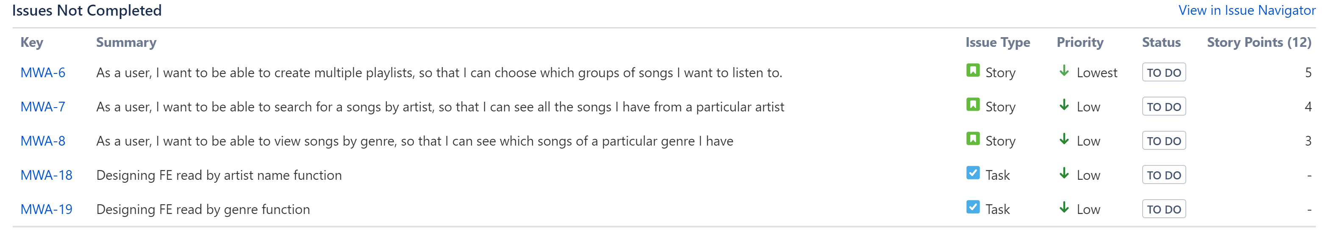

Slide 28
Sprint Retrospective
What went well?
What could be improved?

